Slide 1
Artifact Toolbar
Header
Layout
Card
Image
Text
Border

Slide 2
Distribution Method | Individuals | Groups | Public | 3rd Parties | Subsidiaries | Schedule | Unattended | Link Back | Live Embed
Card Share | • | • |  |  |  |  |  |  | ◌
Story/Page Share | • | • |  |  |  |  |  |  | ◌
Email | • | • |  |  |  | • |  | •
Mobile App | • | •
Published URL | • | • | •
Digital Wallboard | • | • | • |  |  |  | •
Web Page Embed | • | • | • |  |  |  |  |  | •
Domo Everywhere Publish |  |  |  | • | •

Slide 3
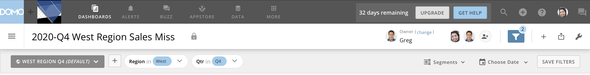

Slide 4
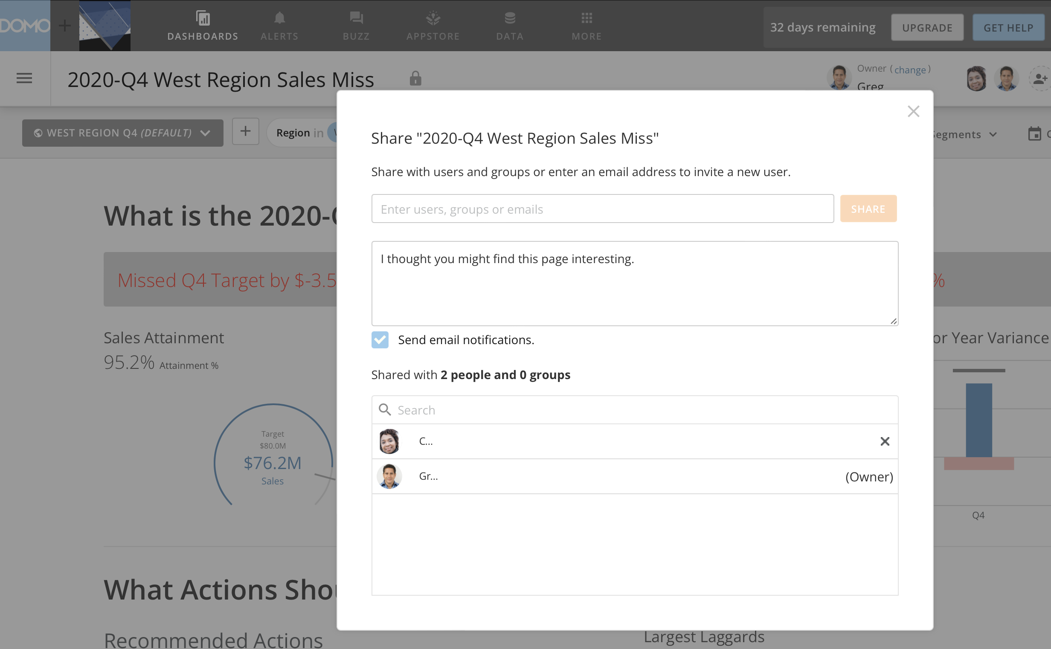

Slide 5
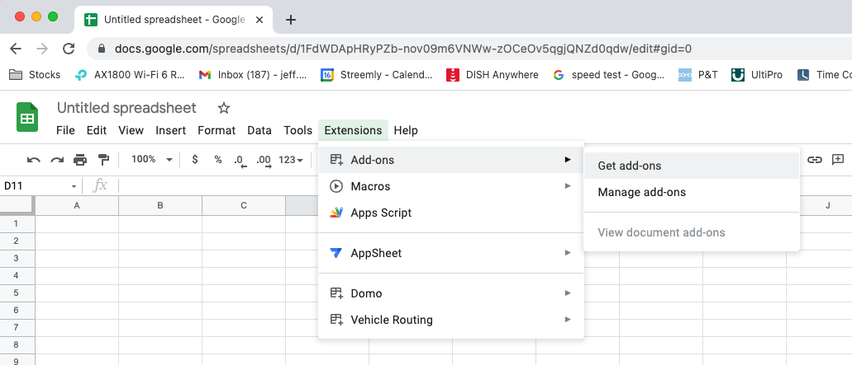

Slide 6
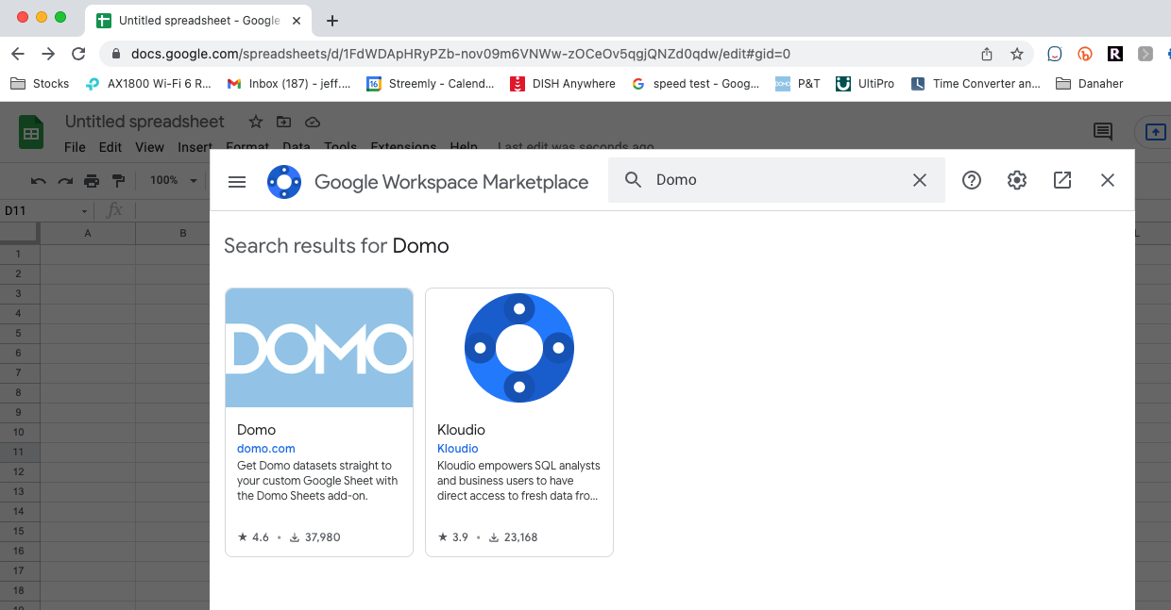

Slide 7
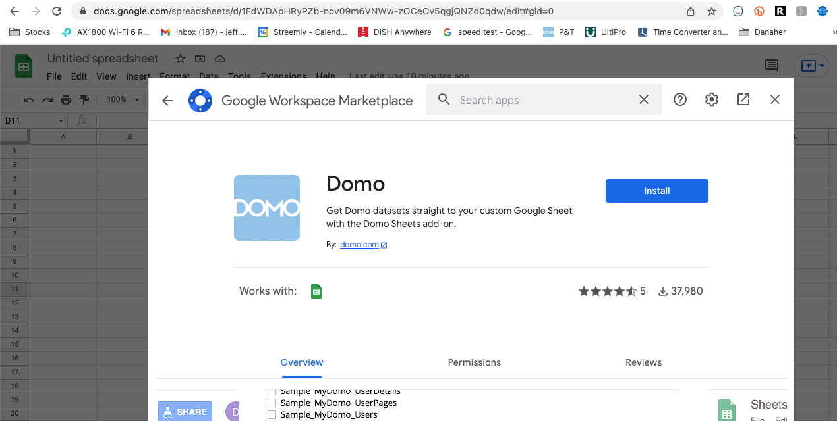

Slide 8
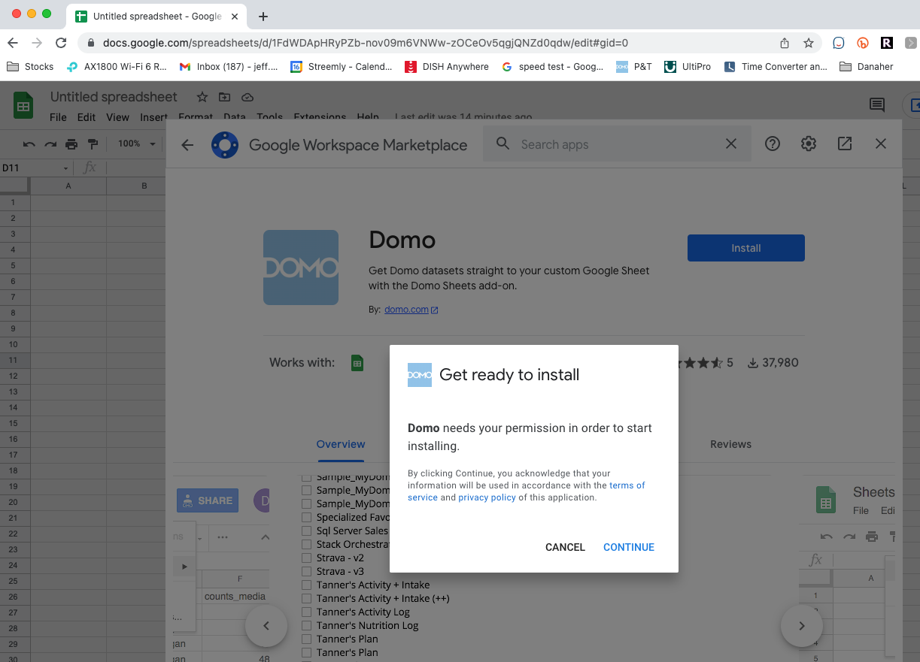

Slide 9
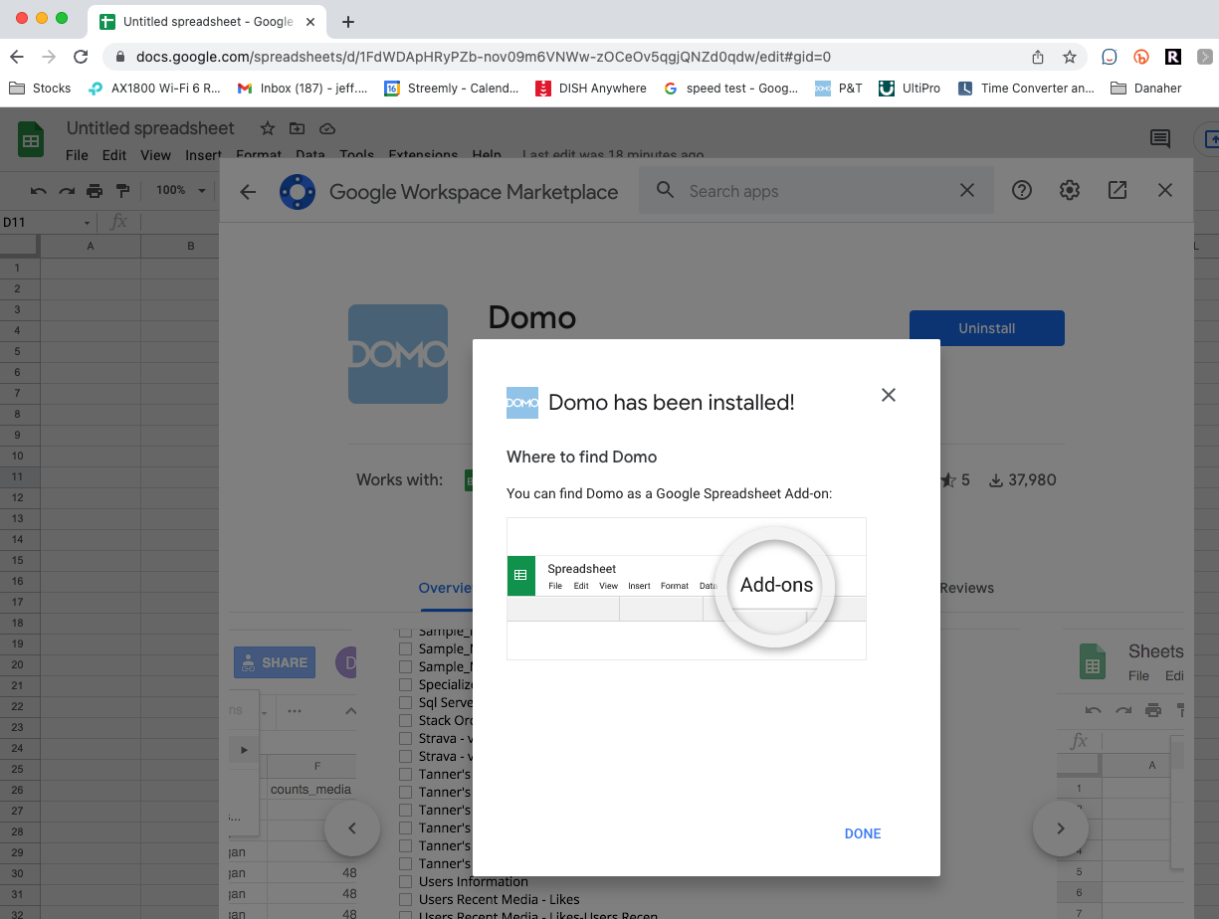

Slide 10
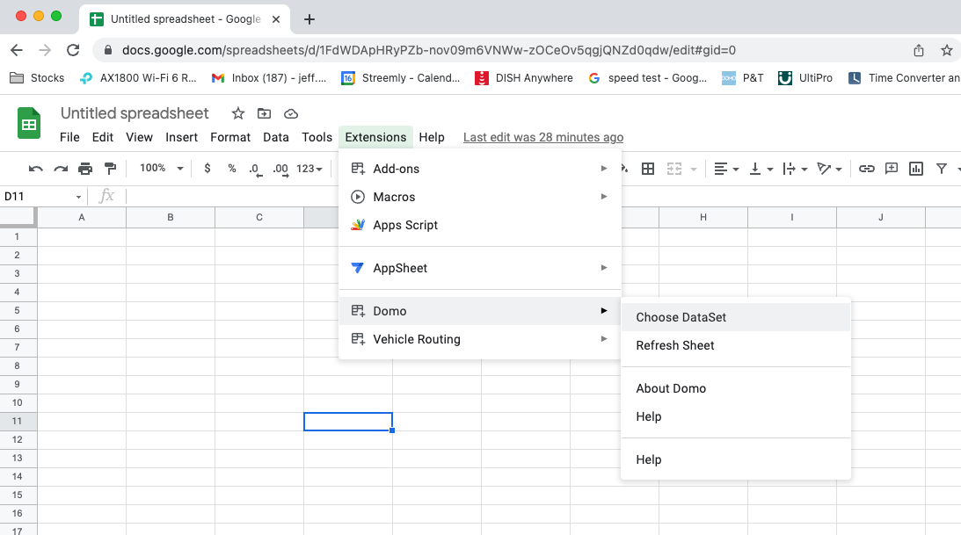

Slide 11
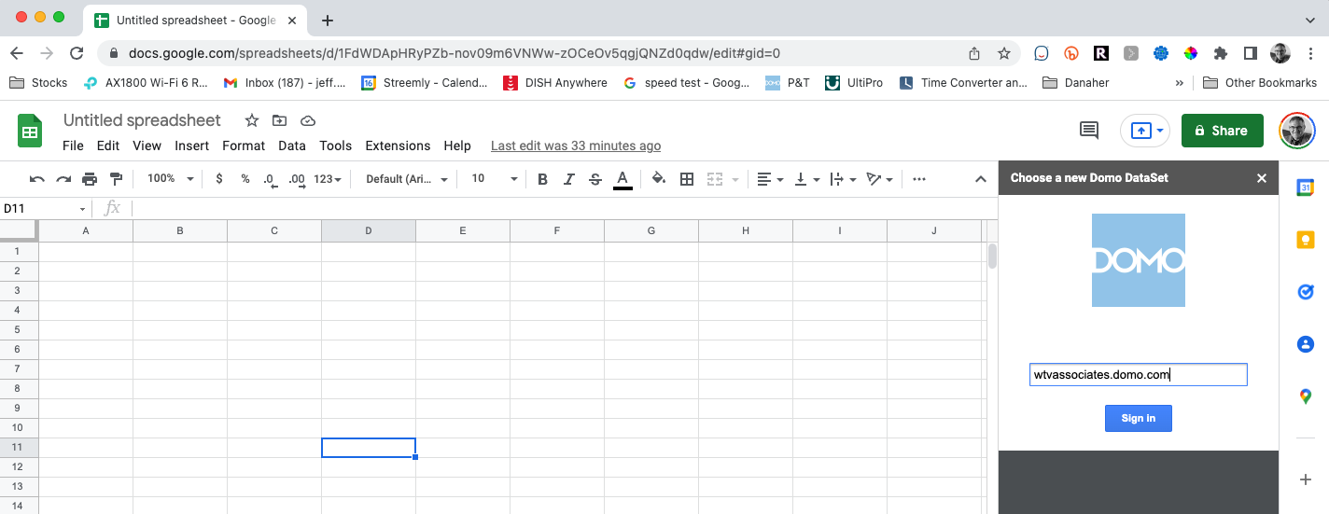

Slide 12
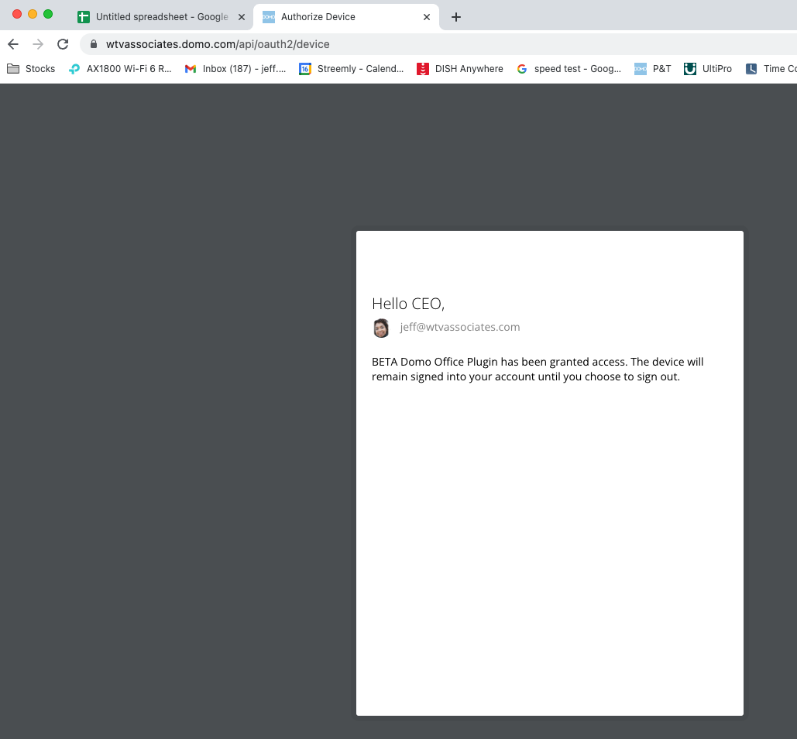

Slide 13
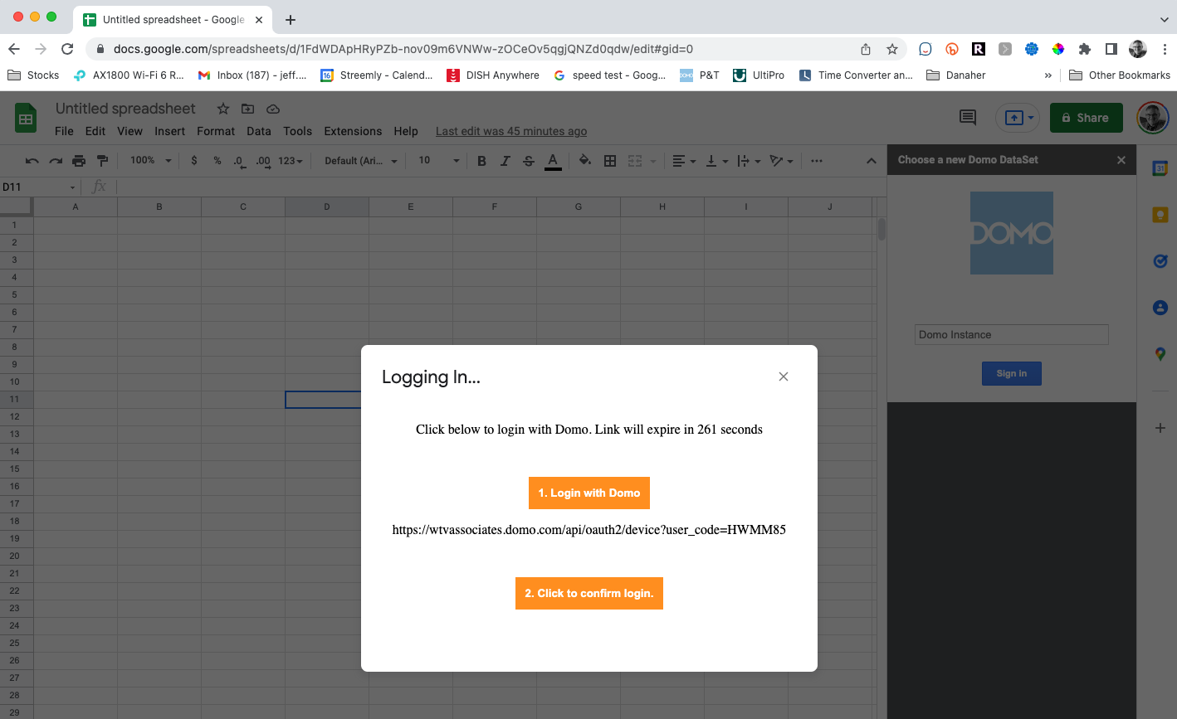

Slide 14
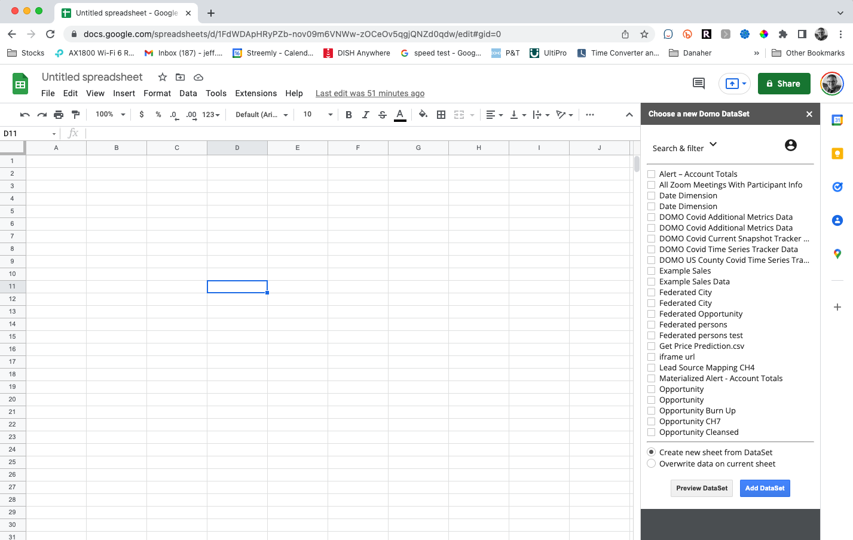

Slide 15
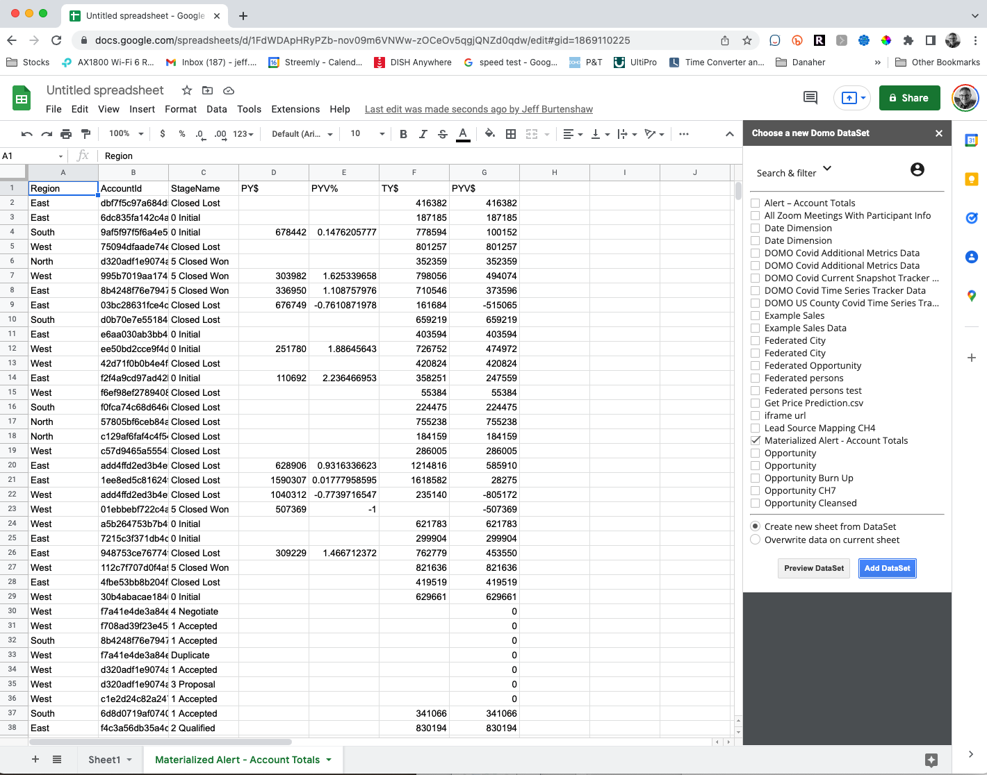

Slide 16
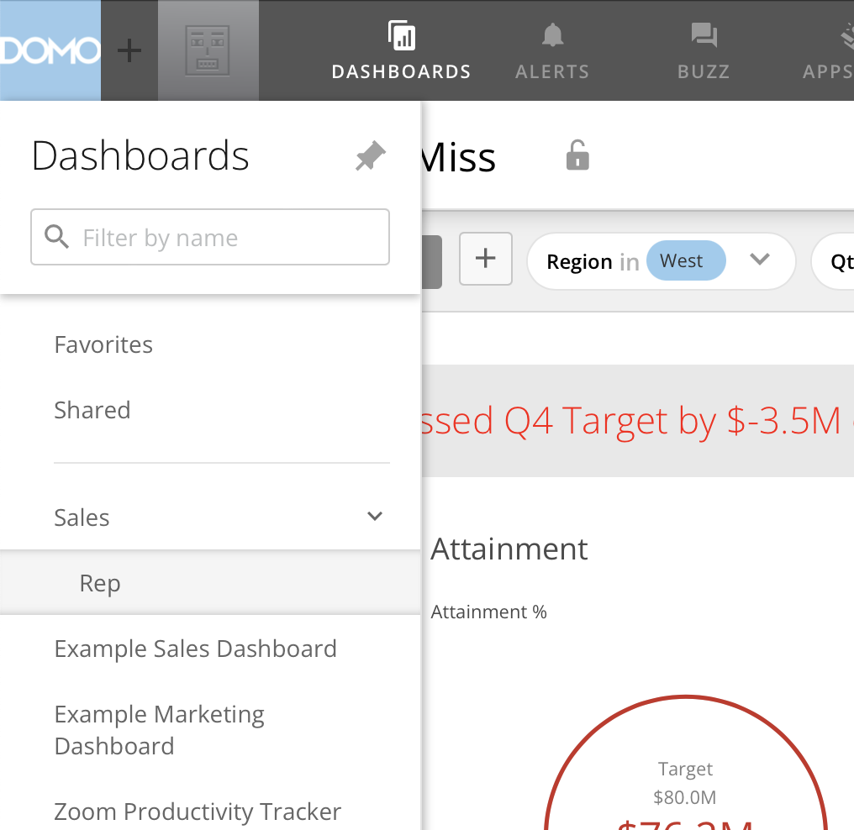

Slide 17
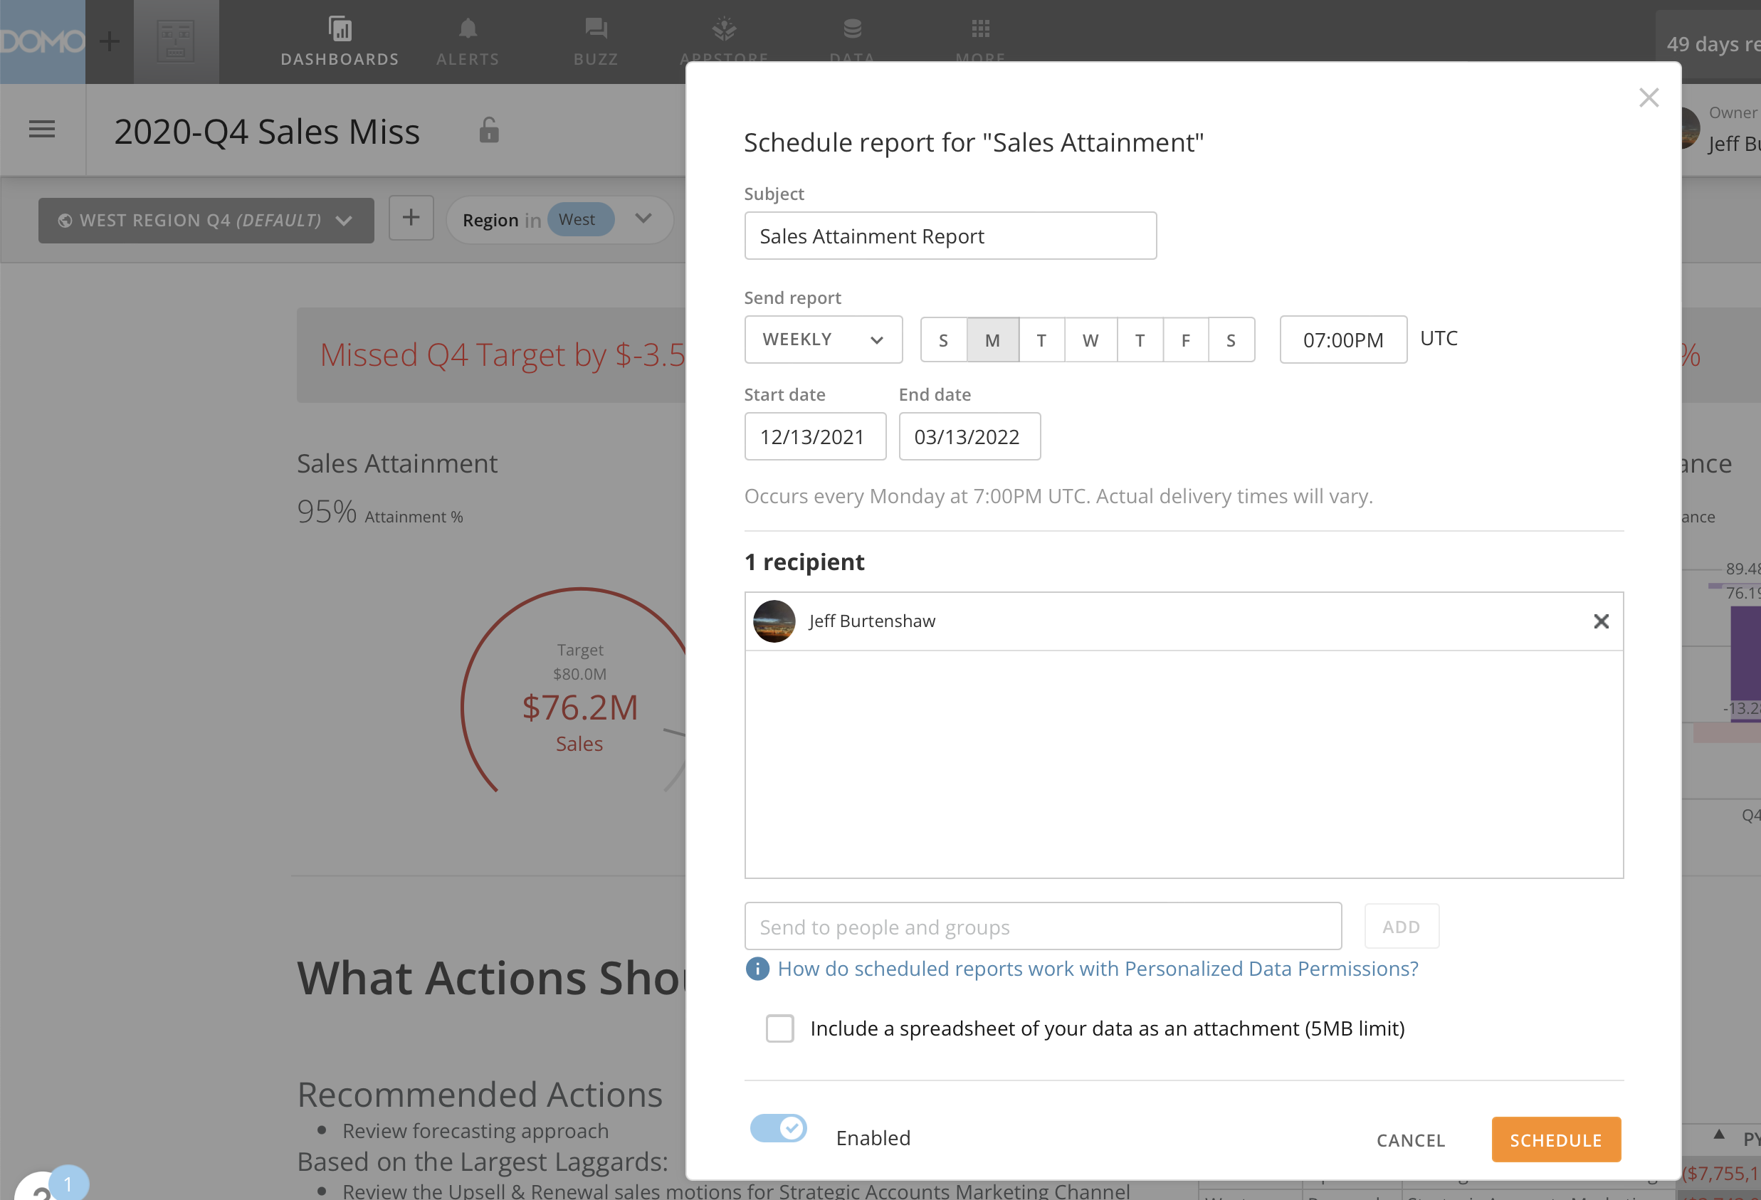

Slide 18
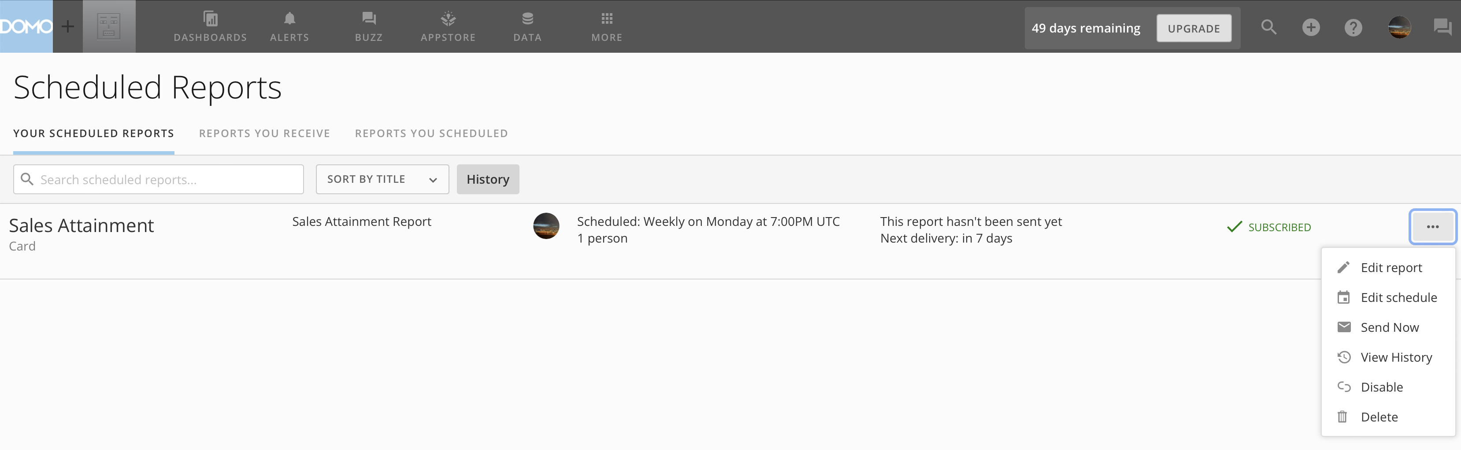

Slide 19
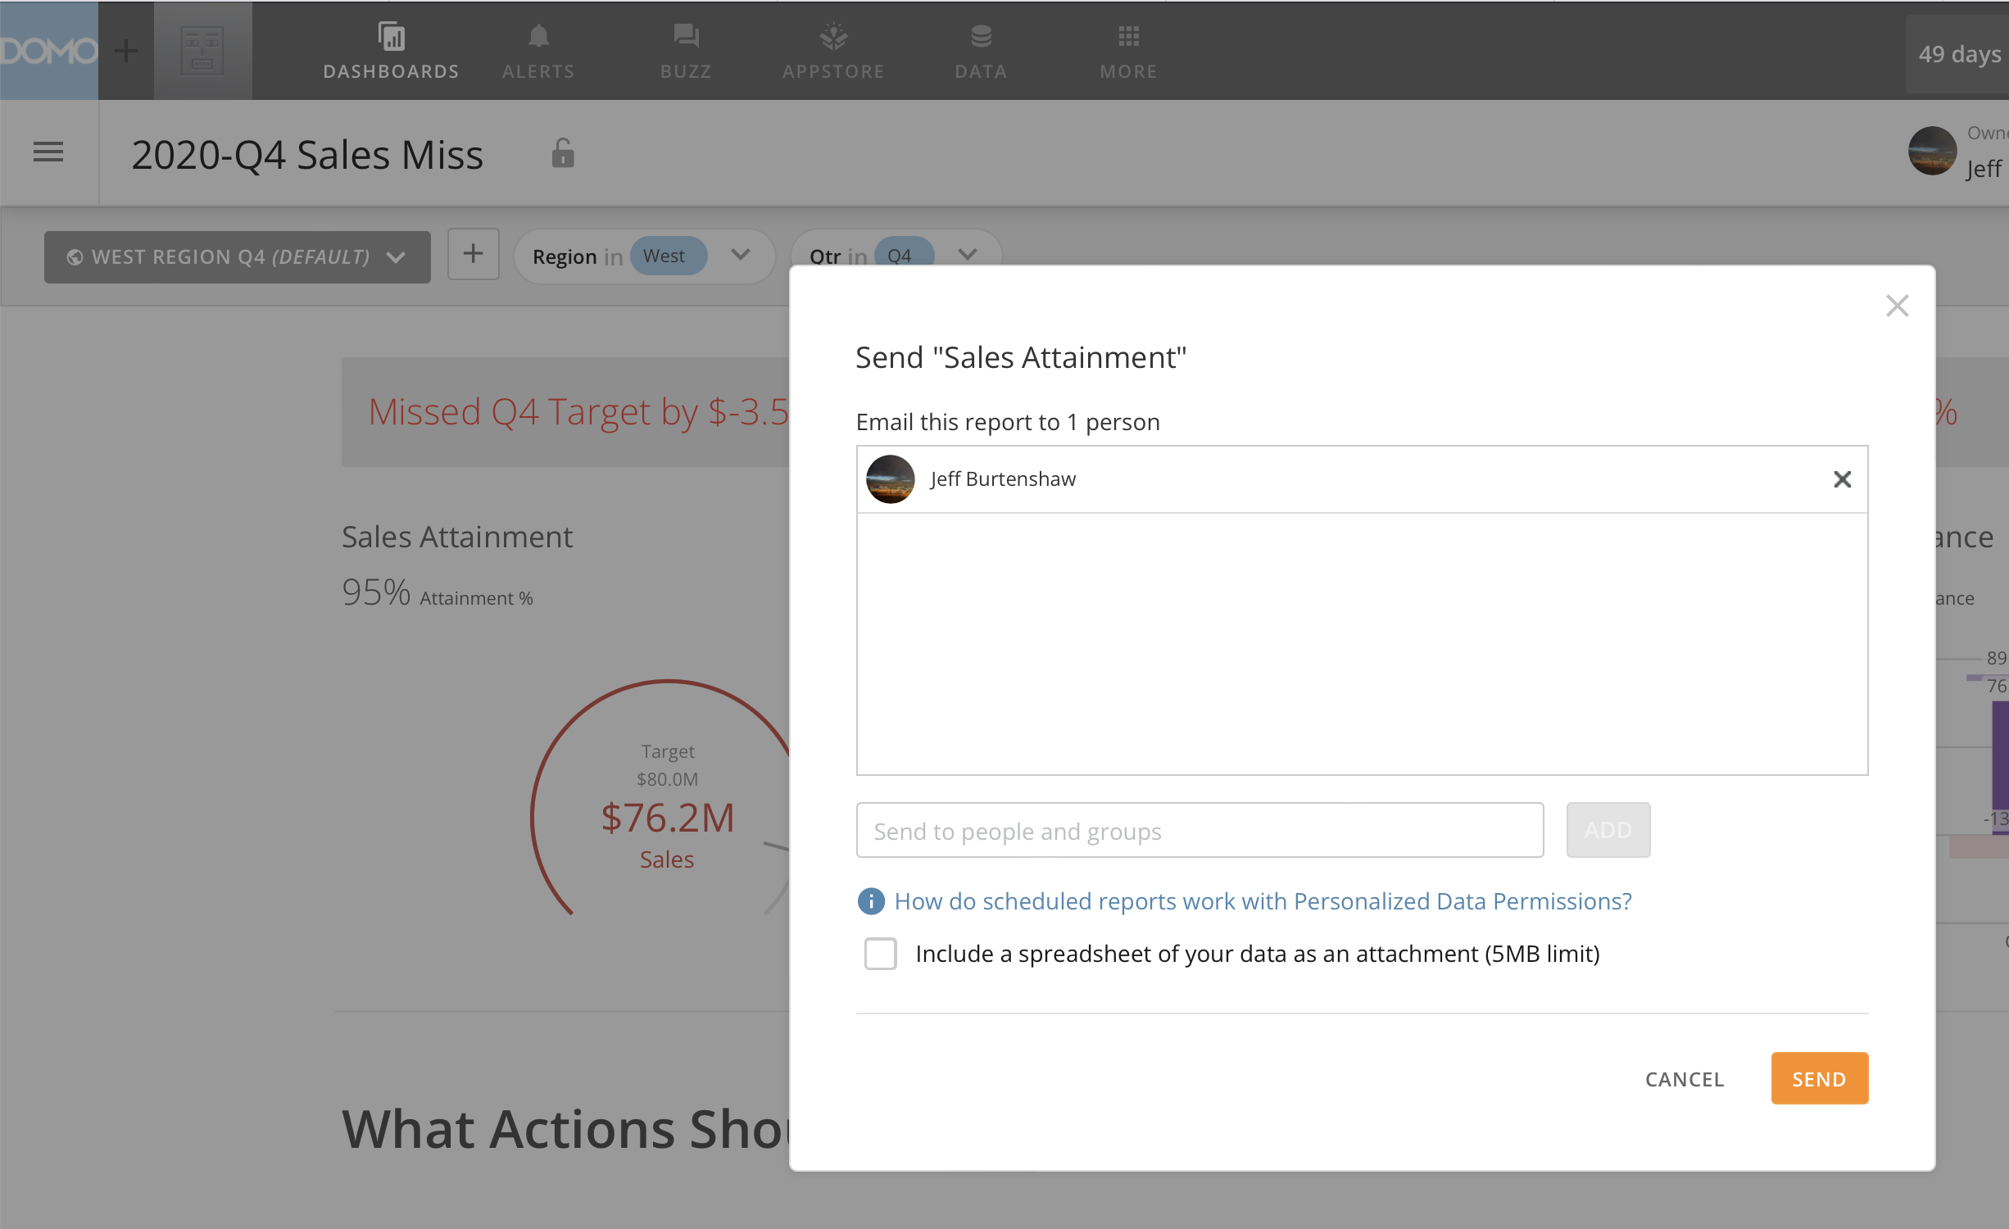

Slide 20
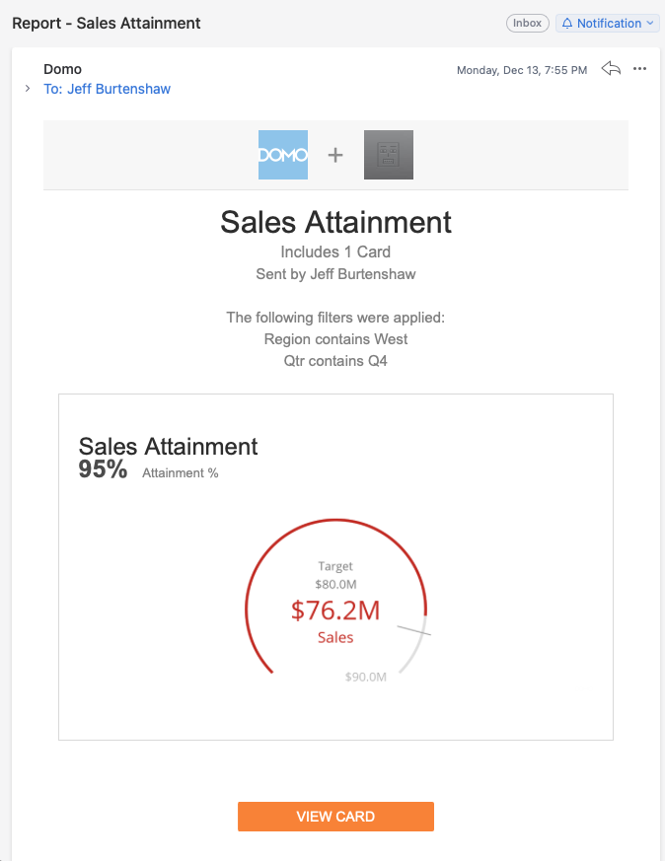

Slide 21
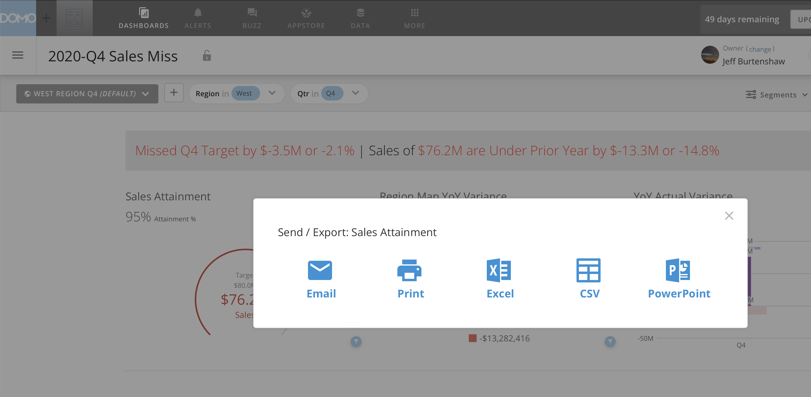

Slide 22
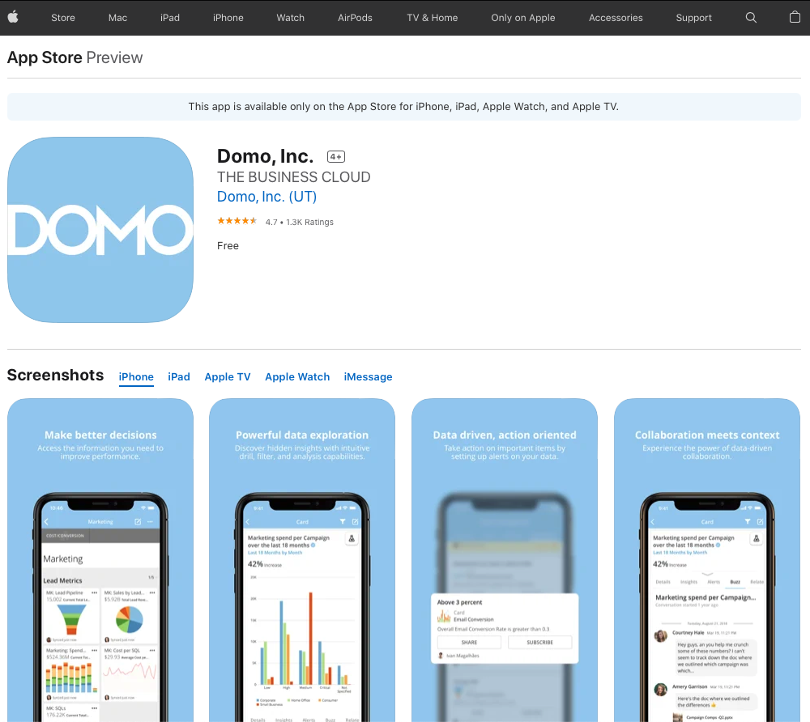
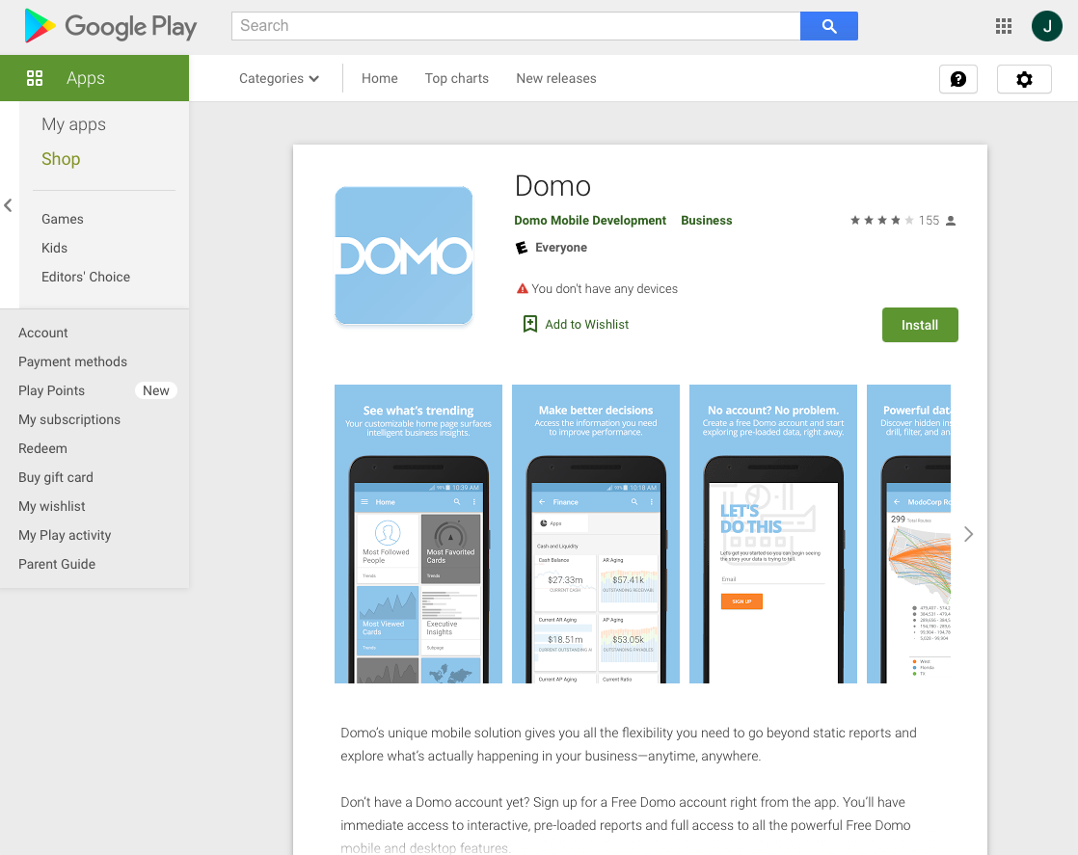
Apple App Store
Google Play Store

Slide 23
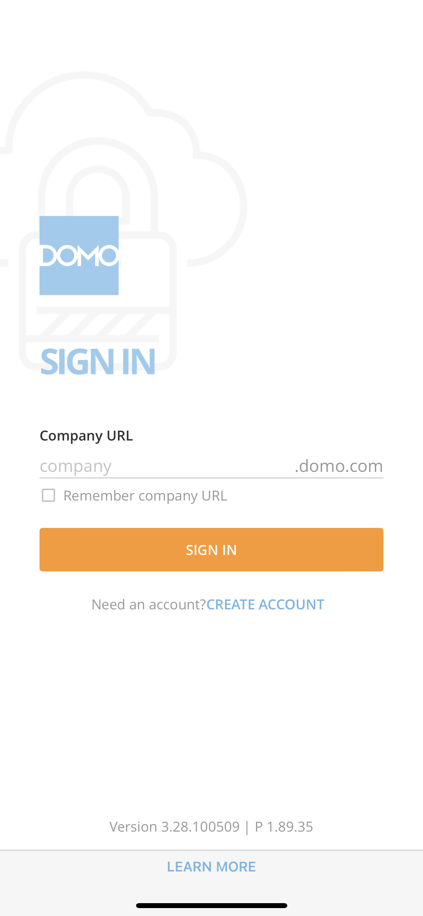

Slide 24
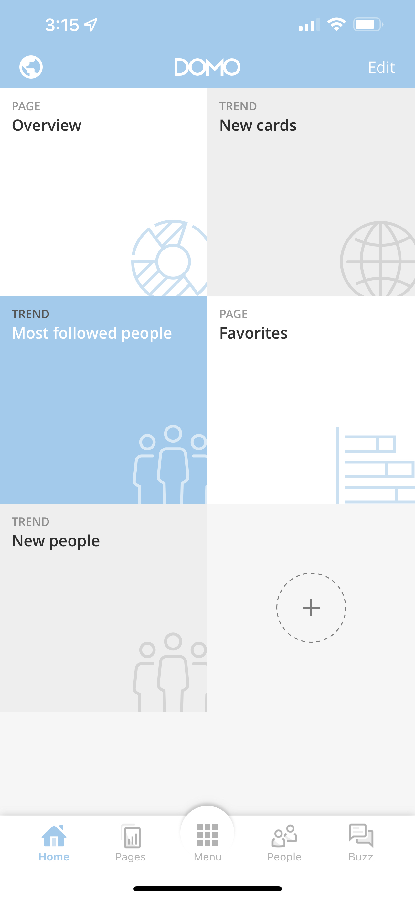
Alerts & Notifications Access
Customize Home Screen
Home Screen Tiles
Add Tile
Home
Buzz
Pages
People
Menu

Slide 25
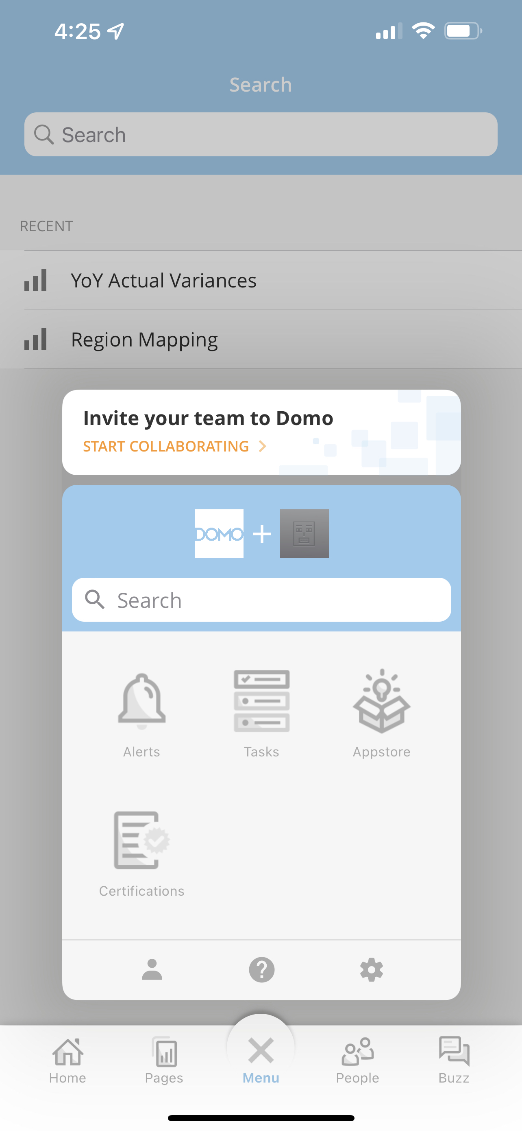
Search
Alerts
Appstore
Tasks
Certifications
Help
Profile
Settings

Slide 26
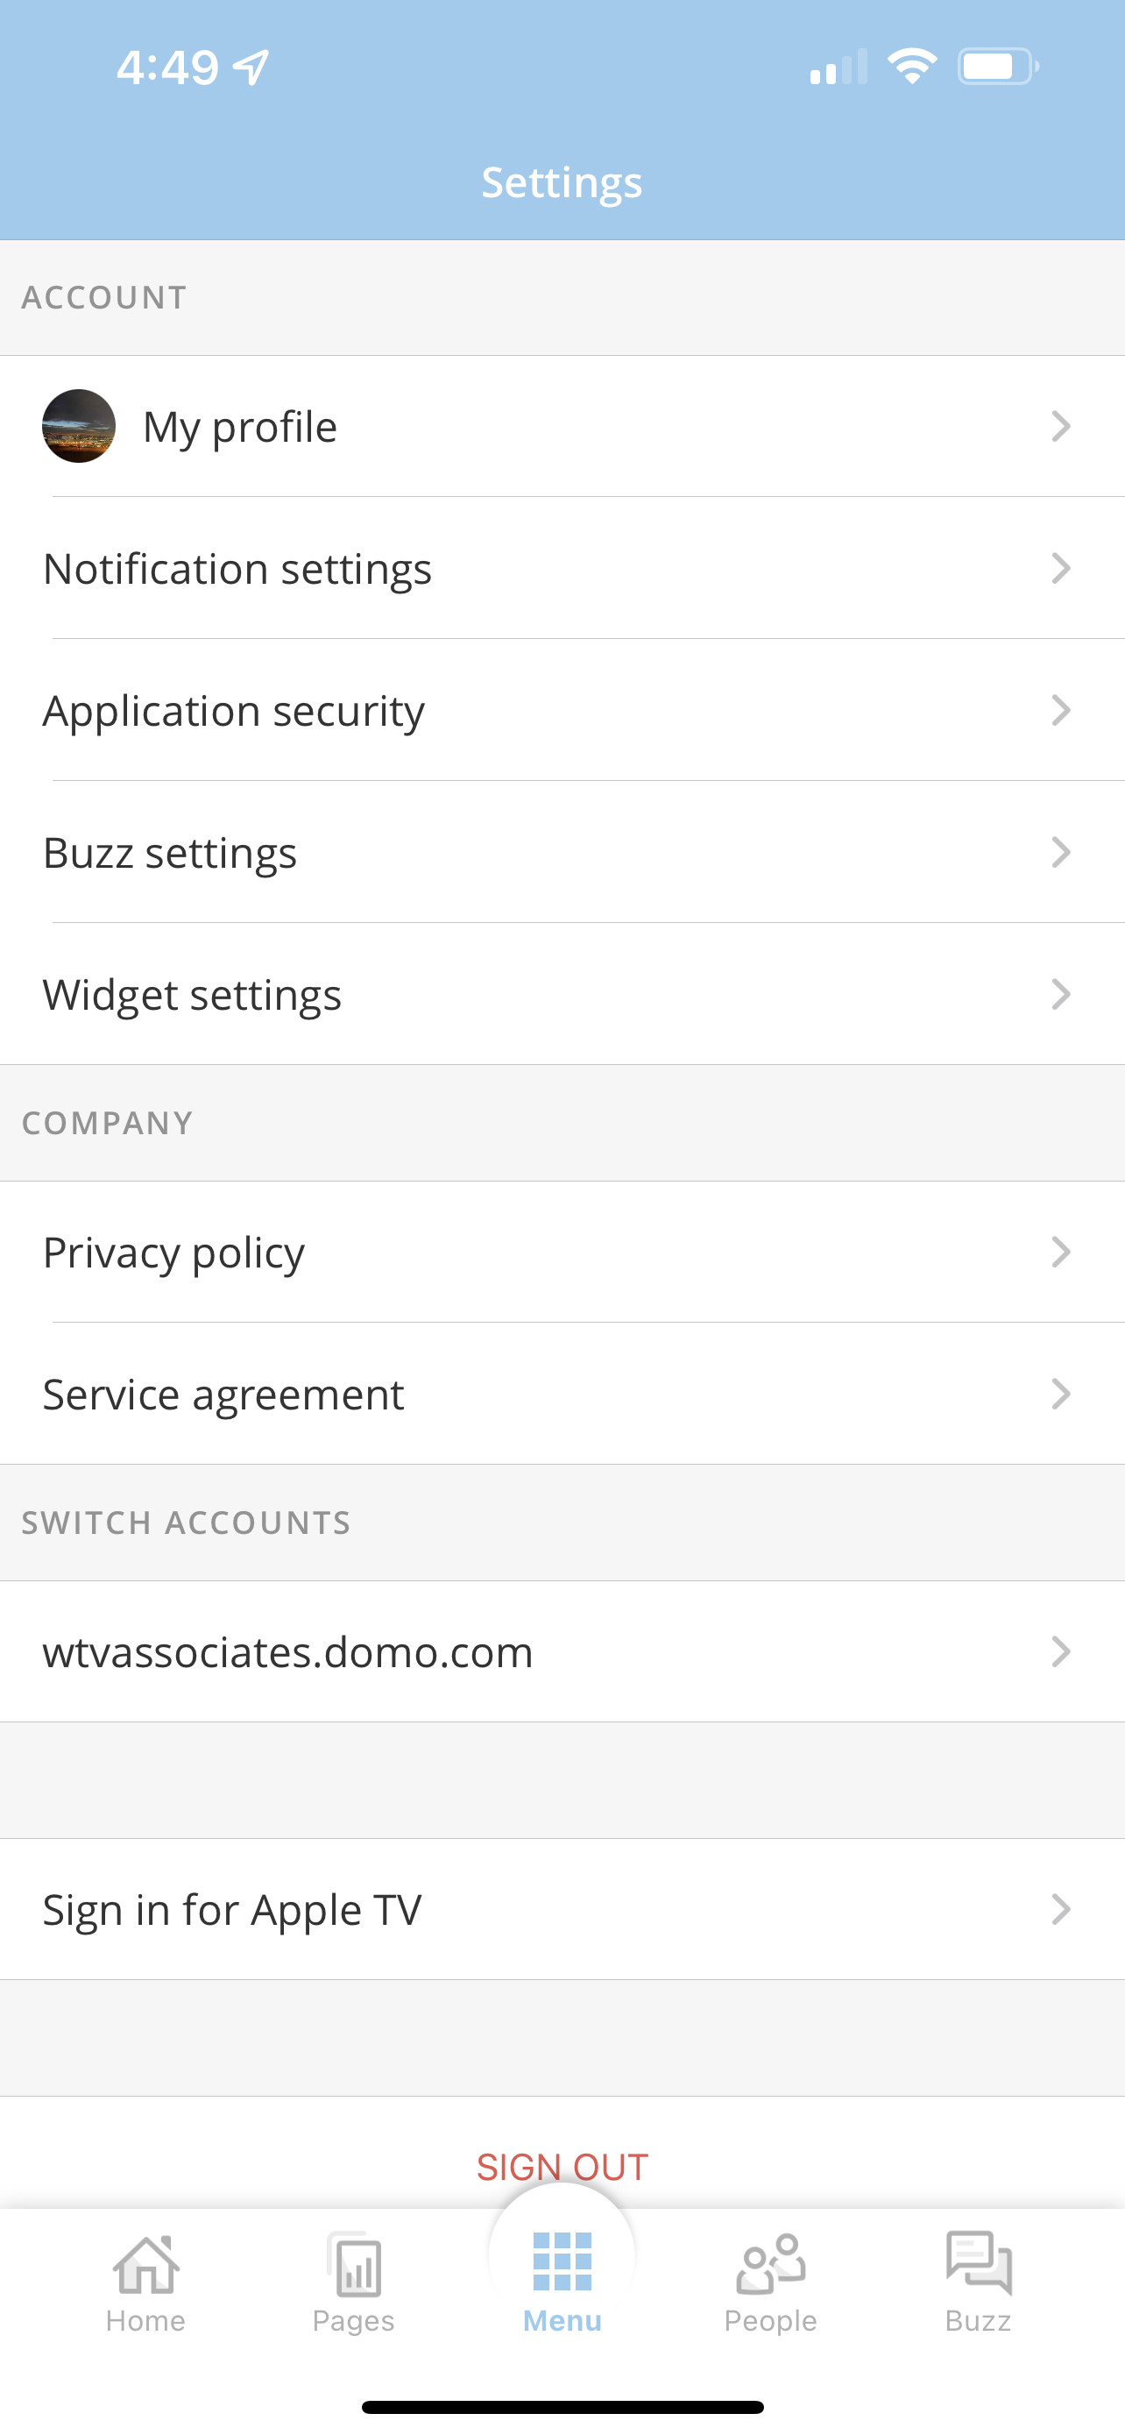

Slide 27
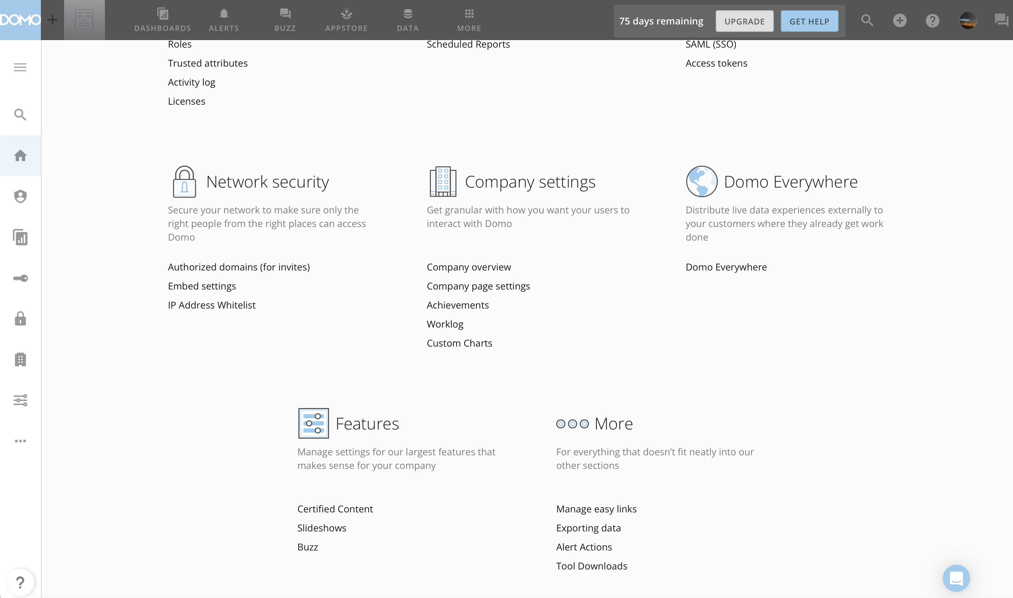

Slide 28
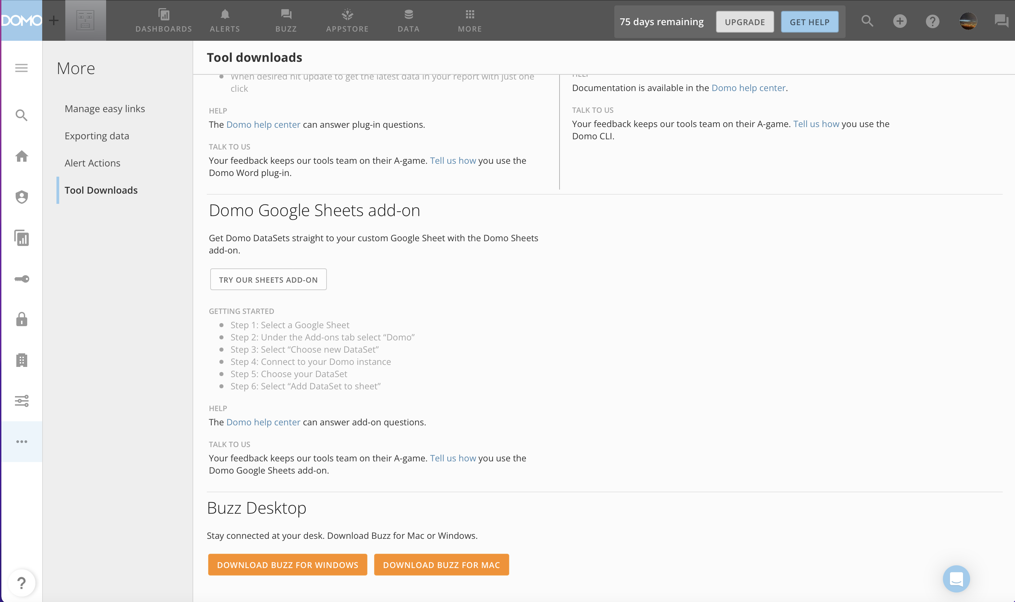

Slide 29
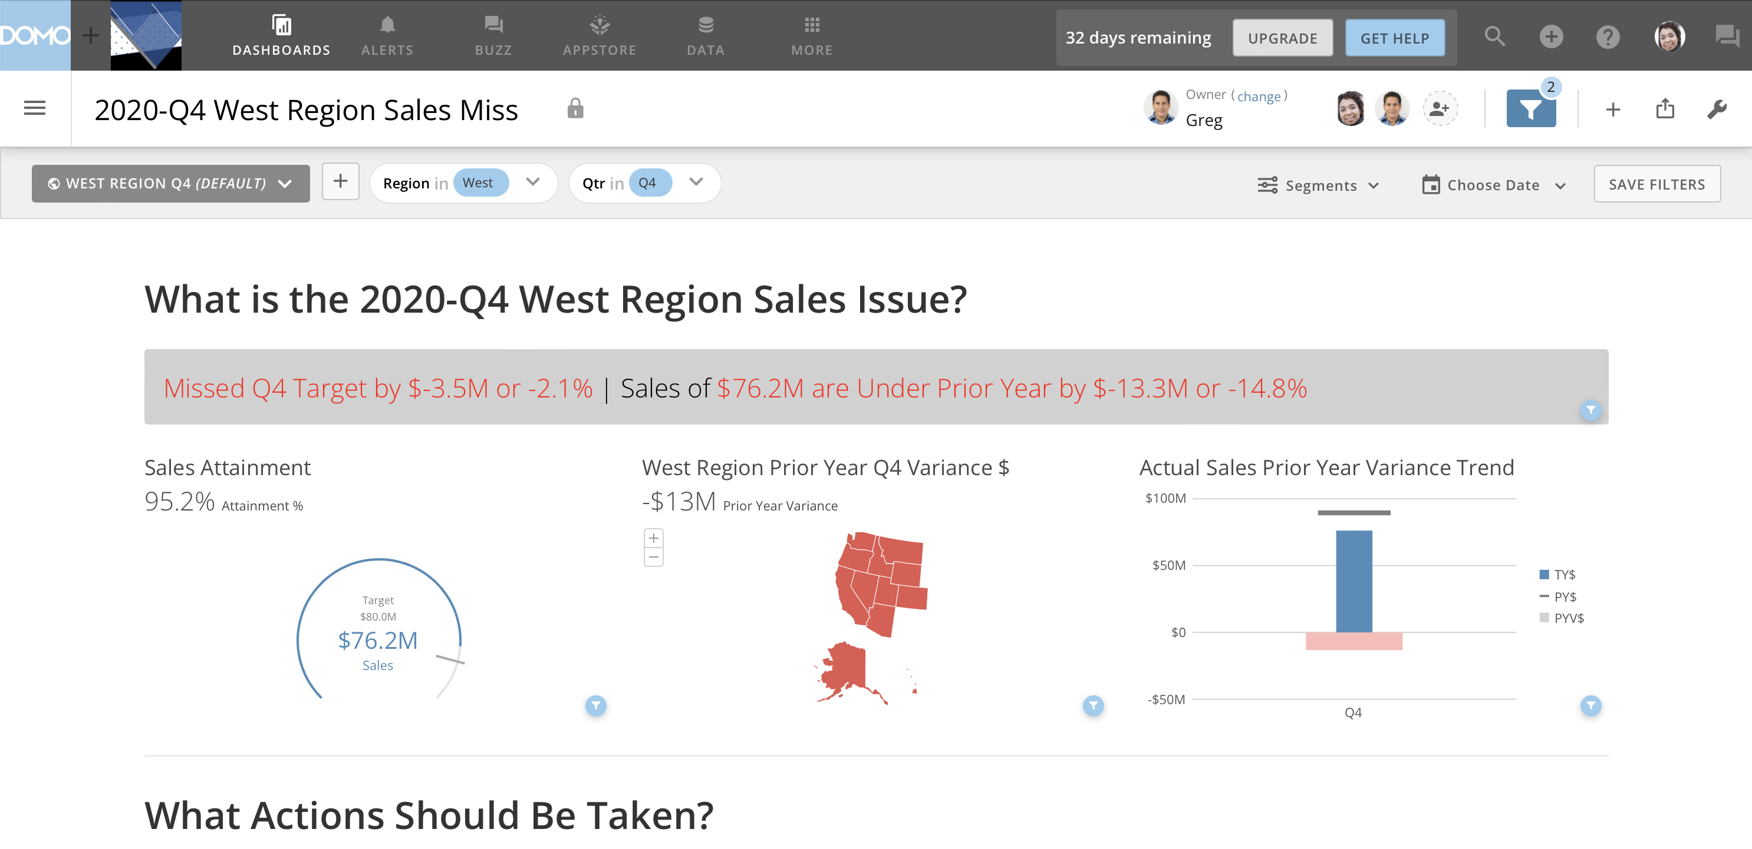

Slide 30
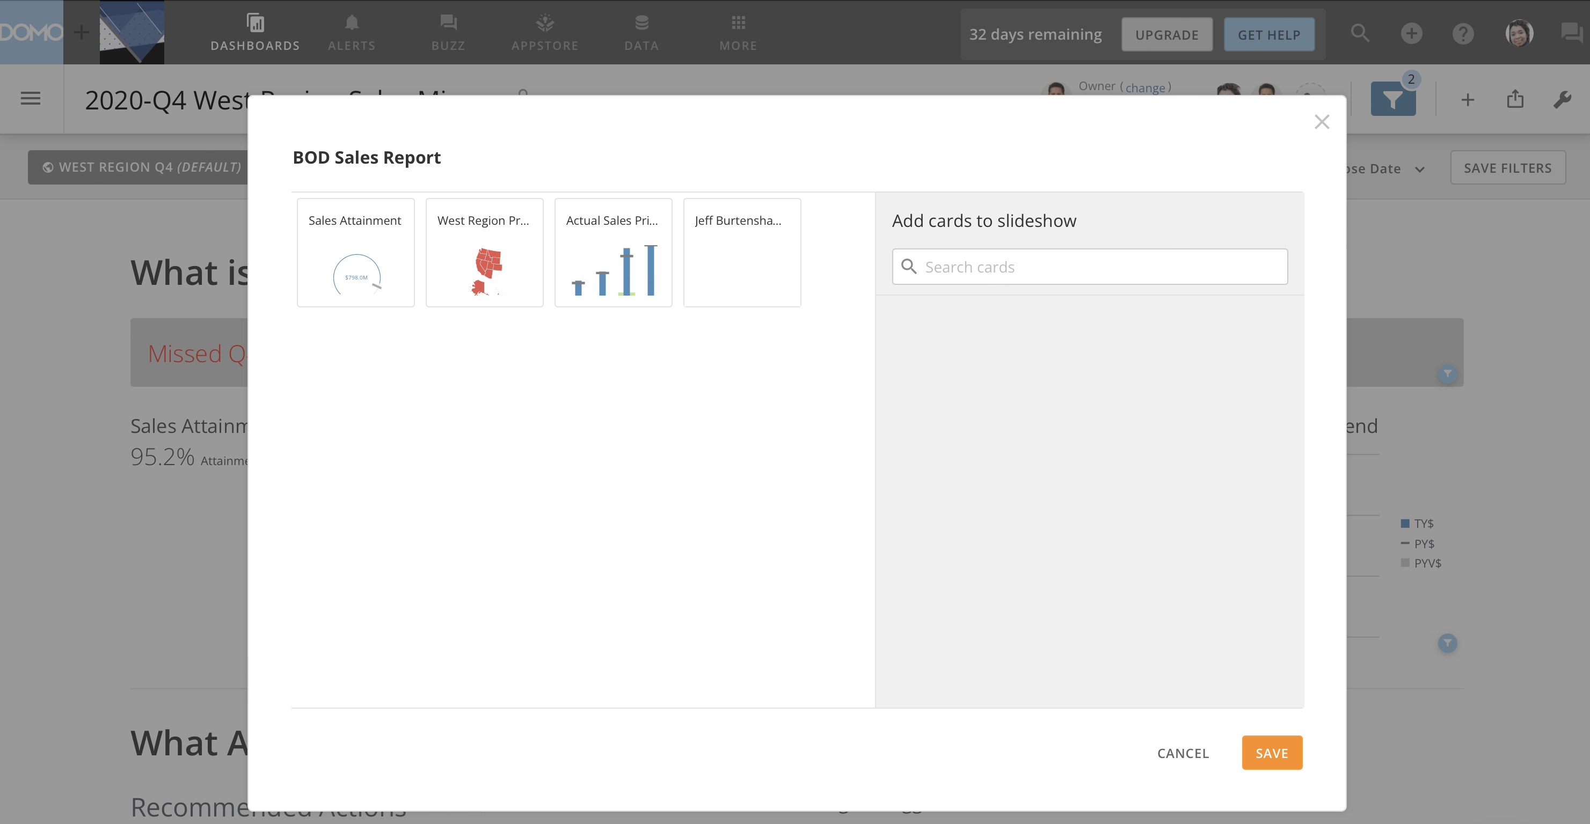

Slide 31
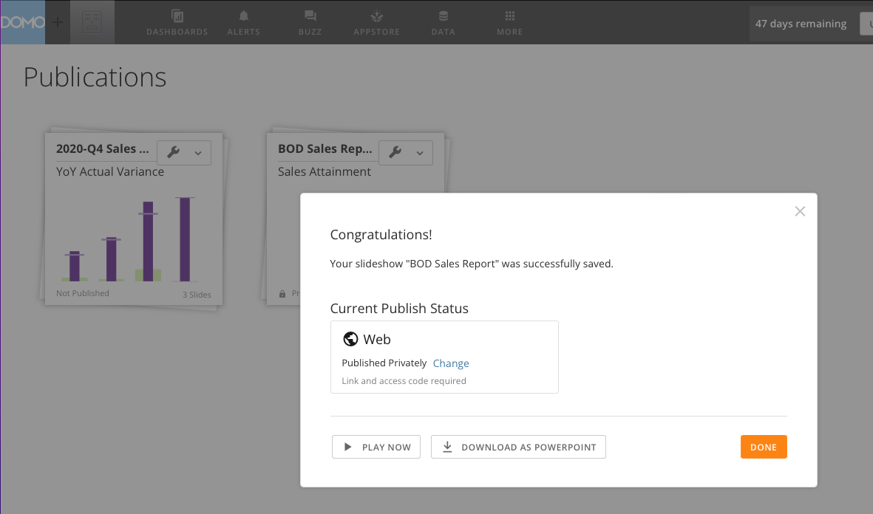

Slide 32
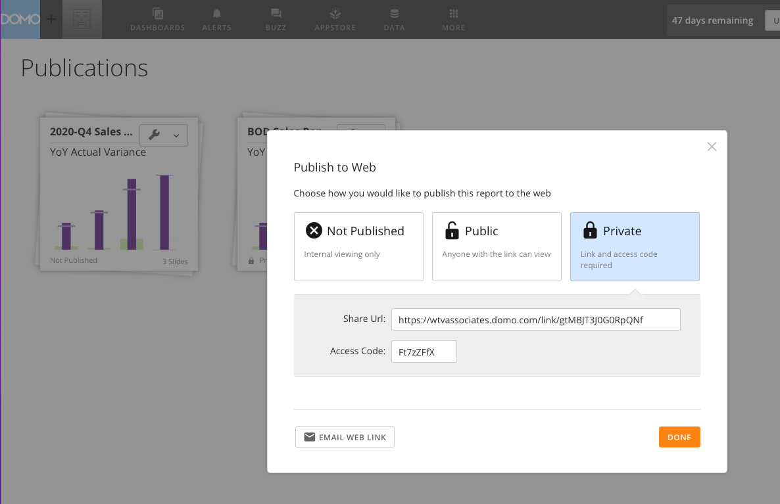

Slide 33
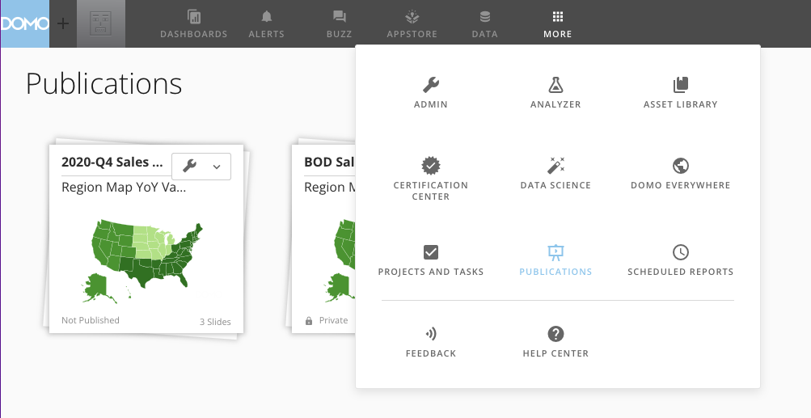

Slide 34
Product | Need | Real World Example
PaaS | Embed Analytics inside a custom application | Retail In-Store Management Analytics
 | Launching a new product that requires analytics | Technology Infrastructure Provider Product Performance Analytics
Portal Embed | Add analytics to an existing web portal | Manufacturer Supplier Portal Large Energy Company PR Portal
 | Add analytics to an intranet | Financial Services Company Employee Intranet Analytics
Orchestrator | Distribute data and dashboards from a central repository across Domo tenants securely | Insurance Company Broker Support Portal

Slide 35
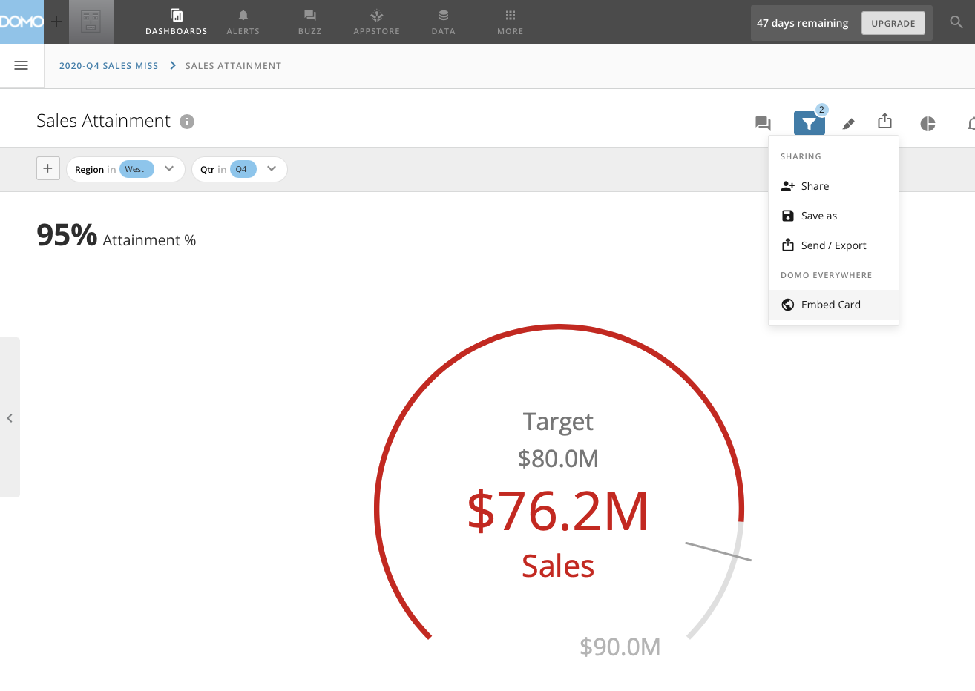

Slide 36
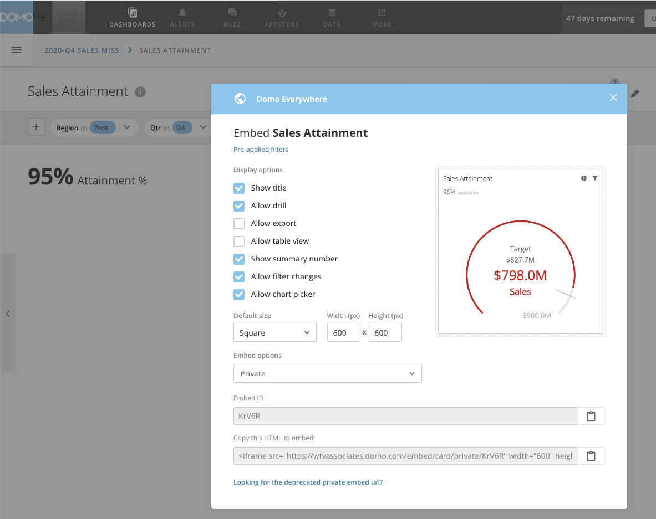

Slide 37
